Slide 1
VASTDATA
数据库基本原理（存储引擎）
北京海量数据技术股份有限公司 【内部资料 严禁外传】

Slide 2
约定
本文只描述行存储引擎，内容仅包含以下模块：
页面结构、HOT、TOAST
快照种类、（多版本）快照、MVCC
CLOG、CSNLOG
XLOG
数据库版本和参数配置：
数据库版本：Vastbase 2.2.10
参数配置：默认参数（非线程池模式），串行回放
操作系统：CentOS Linux release 7.8.2003 (core)
硬件：x86_64

Slide 3
PART 1
页面结构、HOT、TOAST

Slide 4
字段属性
为便于描述，此章节利用以下表结构进行描述：
CREATE TABLE t (
c1 int primary key,
c2 text
);
其中c1为定长（fixed-length）字段，存储时占4个字节，c1为主键，会默认创建一个唯一索引；c2为变长（variable-length）字段，最大存储1GB。不同数据类型在磁盘上的存储方式不同，pg_type系统表中进行了规定。

Slide 5
字段属性
pg_type中关键字段说明如下：
字段名称 | 类型 | 说明
typlen | int2 | For a fixed-size type, typlen is the number of bytes in the internal representation of the type. But for a variable-length type, typlen is negative. -1 indicates a “varlena” type (one that has a length word), -2 indicates a null-terminated C string.
typbyval | bool | typbyval determines whether internal routines pass a value of this type by value or by reference. typbyval had better be false if typlen is not 1, 2, or 4 (or 8 on machines where Datum is 8 bytes). Variable-length types are always passed by reference. Note that typbyval can be false even if the length would allow pass-by-value.
typalign | char | typalign is the alignment required when storing a value of this type. It applies to storage on disk as well as most representations of the value inside Vastbase. When multiple values are stored consecutively, such as in the representation of a complete row on disk, padding is inserted before a datum of this type so that it begins on the specified boundary. The alignment reference is the beginning of the first datum in the sequence. Possible values are: c = char alignment, i.e., no alignment needed. s = short alignment (2 bytes on most machines). i = int alignment (4 bytes on most machines). d = double alignment (8 bytes on many machines, but by no means all).
typstorage | char | typstorage tells for varlena types (those with typlen = -1) if the type is prepared for toasting and what the default strategy for attributes of this type should be. Possible values are: p (plain): Values must always be stored plain (non-varlena types always use this value). e (external): Values can be stored in a secondary “TOAST” relation (if relation has one, see pg_class.reltoastrelid). m (main): Values can be compressed and stored inline. x (extended): Values can be compressed and/or moved to a secondary relation. x is the usual choice for toast-able types. Note that m values can also be moved out to secondary storage, but only as a last resort (e and x values are moved first).

Slide 6
页面结构
对表t执行以下操作：
事务T1:
insert into t values (1, 'hello');
事务T2:
begin;
update t set c2 = 'hello world' where c1 = 1;
insert into t values (2, 'foobar');
commit;

Slide 7
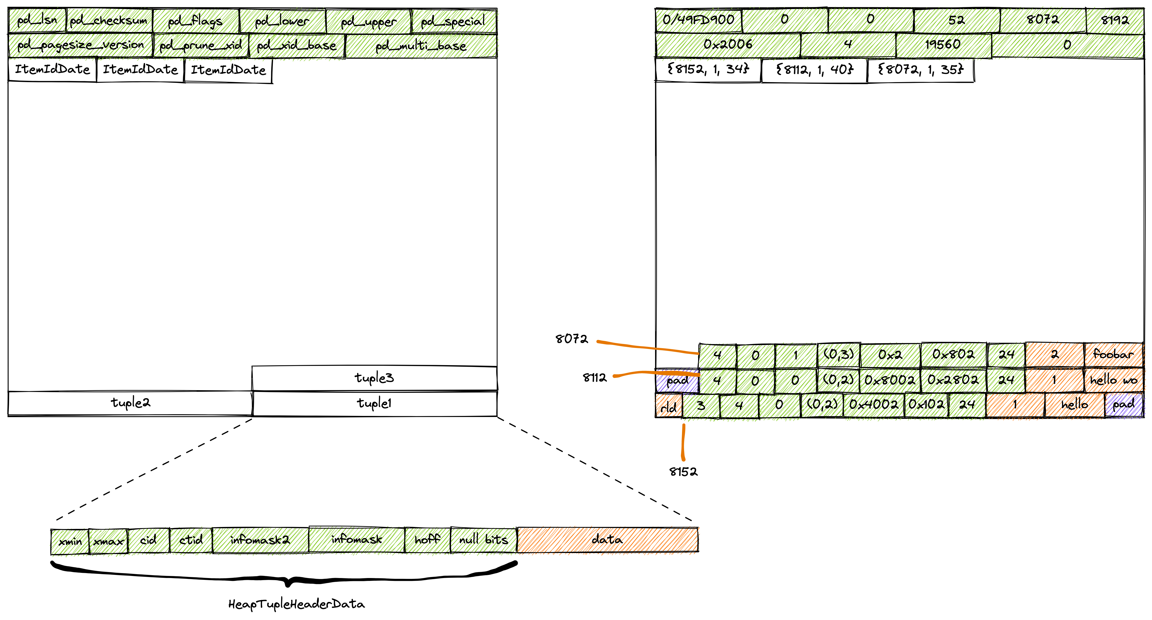
页面结构

Slide 8
HOT（Heap Only Tuple）
Vastbase中索引条目记录的是元组在堆表中的tid（blockno, offset），以前文示例，事务T1插入一条记录，会在索引中维护一个条目，对应的tid为（0, 1），表示0号块的第一条元组。事务T2更新了“c1 = 1”的记录，但更新的并非索引字段（c2），产生的新元组的tid为（0, 2），此时一种常规的做法是为新记录新增一个索引条目，这样做带来以下问题：
需要维护索引；
索引字段（c1）未变化，索引树中的字段值相同；
Vastbase为解决此问题引入Heap Only Tuple（HOT）技术：若当前页面有足够空闲空间（能放下新的元组）且并未更新索引字段，则更新旧元组的tid并设置相关bit位，而不需要维护索引。当索引扫描时根据索引条目中记录的tid（0, 1）找到第一条元组，然后顺着HOT链（通过tid串起来）遍历。

Slide 9
Broken HOT chain
Everything is a trade-off. 引入HOT技术带来一些问题。前文的表t在创建时已经给c1字段建立索引，更新c2字段可以遵循HOT原则，倘若表t开始没有索引，后续才建立索引，会发生怎样的情况呢？考虑如下场景：
CREATE TABLE t (
c1 int,
c2 text
);
事务T1: insert into t values (1, 'hello');
事务T2: update t set c1 = 2 where c2 = 'hello';
事务T3: update t set c1 = 3 where c2 = 'hello';
事务T4: update t set c1 = 4 where c2 = 'hello';
事务T5: create index idx_t_c1 on t(c1);
在事务T5之前表t更新操作会遵循HOT，但事务T5对c1字段建立索引，索引中应该记录多少条记录？

Slide 10
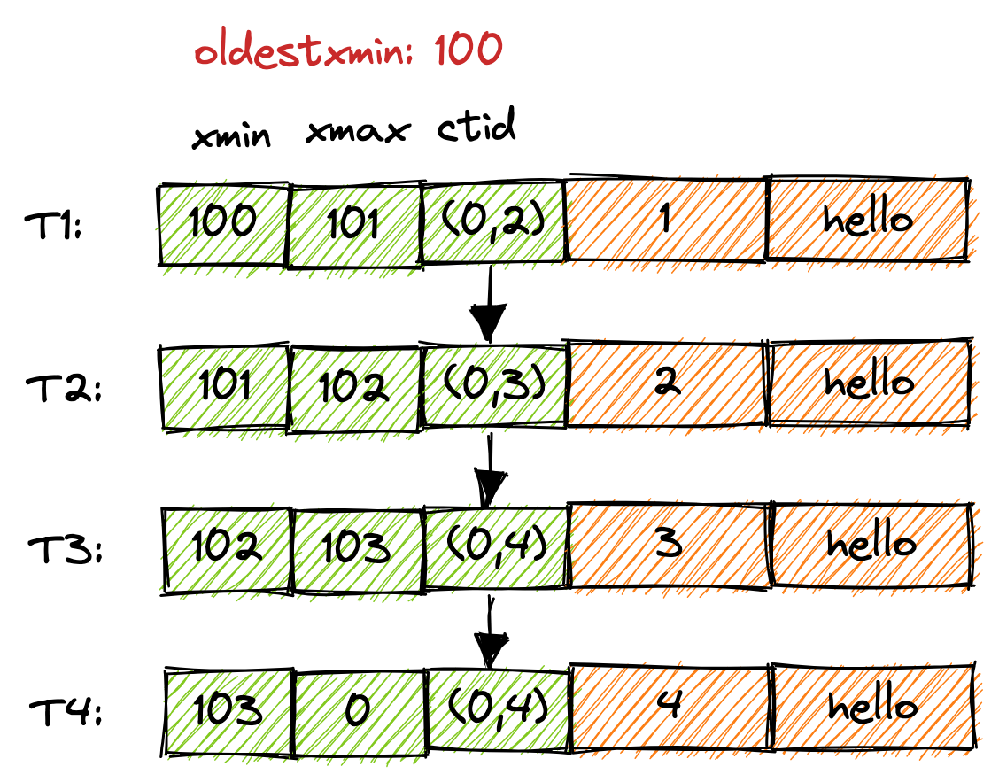
Broken HOT chain
目前Vastbase在创建索引时遇到这种情况，索引中只会记录事务T4产生的记录，这使得某些快照在扫描表t时不能使用索引idx_t_c1。为解决此问题，系统表pg_index中有个字段indcheckxmin：
If true, queries must not use the index until the xmin of this pg_index row is below their TransactionXmin event horizon, because the table may contain broken HOT chains with incompatible rows that they can see.

Slide 11
TOAST
Vastbase uses a fixed page size (commonly 8 kB), and does not allow tuples to span multiple pages. Therefore, it is not possible to store very large field values directly. To overcome this limitation, large field values are compressed and/or broken up into multiple physical rows. This happens transparently to the user, with only small impact on most of the backend code. The technique is affectionately known as TOAST.
Only certain data types support TOAST — there is no need to impose the overhead on data types that cannot produce large field values. To support TOAST, a data type must have a variable-length (varlena) representation, in which, ordinarily, the first four-byte word of any stored value contains the total length of the value in bytes (including itself). TOAST does not constrain the rest of the data type's representation. The special representations collectively called TOASTed values work by modifying or reinterpreting this initial length word. Therefore, the C-level functions supporting a TOAST-able data type must be careful about how they handle potentially TOASTed input values: an input might not actually consist of a four-byte length word and contents until after it's been detoasted.
TOAST usurps two bits of the varlena length word (the high-order bits on big-endian machines, the low-order bits on little-endian machines), thereby limiting the logical size of any value of a TOAST-able data type to 1 GB (2³⁰ - 1 bytes). When both bits are zero, the value is an ordinary un-TOASTed value of the data type, and the remaining bits of the length word give the total datum size (including length word) in bytes. When the highest-order or lowest-order bit is set, the value has only a single-byte header instead of the normal four-byte header, and the remaining bits of that byte give the total datum size (including length byte) in bytes. This alternative supports space-efficient storage of values shorter than 127 bytes, while still allowing the data type to grow to 1 GB at need. Values with single-byte headers aren't aligned on any particular boundary, whereas values with four-byte headers are aligned on at least a four-byte boundary; this omission of alignment padding provides additional space savings that is significant compared to short values. As a special case, if the remaining bits of a single-byte header are all zero (which would be impossible for a self-inclusive length), the value is a pointer to out-of-line data. The type and size of such a TOAST pointer are determined by a code stored in the second byte of the datum. Lastly, when the highest-order or lowest-order bit is clear but the adjacent bit is set, the content of the datum has been compressed and must be decompressed before use. In this case the remaining bits of the four-byte length word give the total size of the compressed datum, not the original data. Note that compression is also possible for out-of-line data but the varlena header does not tell whether it has occurred — the content of the TOAST pointer tells that, instead.

Slide 12
Out-of-Line, On-Disk TOAST Storage
If any of the columns of a table are TOAST-able, the table will have an associated TOAST table, whose OID is stored in the table's pg_class.reltoastrelid entry. On-disk TOASTed values are kept in the TOAST table, as described in more detail below.
Out-of-line values are divided (after compression if used) into chunks of at most TOAST_MAX_CHUNK_SIZE bytes (by default this value is chosen so that four chunk rows will fit on a page, making it about 2000 bytes). Each chunk is stored as a separate row in the TOAST table belonging to the owning table. Every TOAST table has the columns chunk_id (an OID identifying the particular TOASTed value), chunk_seq (a sequence number for the chunk within its value), and chunk_data (the actual data of the chunk). A unique index on chunk_id and chunk_seq provides fast retrieval of the values. A pointer datum representing an out-of-line on-disk TOASTed value therefore needs to store the OID of the TOAST table in which to look and the OID of the specific value (its chunk_id). For convenience, pointer datums also store the logical datum size (original uncompressed data length), physical stored size (different if compression was applied), and the compression method used, if any. Allowing for the varlena header bytes, the total size of an on-disk TOAST pointer datum is therefore 18 bytes regardless of the actual size of the represented value.
The TOAST management code is triggered only when a row value to be stored in a table is wider than TOAST_TUPLE_THRESHOLD bytes (normally 2 kB). The TOAST code will compress and/or move field values out-of-line until the row value is shorter than TOAST_TUPLE_TARGET bytes (also normally 2 kB, adjustable) or no more gains can be had. During an UPDATE operation, values of unchanged fields are normally preserved as-is; so an UPDATE of a row with out-of-line values incurs no TOAST costs if none of the out-of-line values change.

Slide 13
Out-of-Line, In-Memory TOAST Storage
TOAST pointers can point to data that is not on disk, but is elsewhere in the memory of the current server process. Such pointers obviously cannot be long-lived, but they are nonetheless useful. There are currently two sub-cases: pointers to indirect data and pointers to expanded data.
Indirect TOAST pointers simply point at a non-indirect varlena value stored somewhere in memory. This case was originally created merely as a proof of concept, but it is currently used during logical decoding to avoid possibly having to create physical tuples exceeding 1 GB (as pulling all out-of-line field values into the tuple might do). The case is of limited use since the creator of the pointer datum is entirely responsible that the referenced data survives for as long as the pointer could exist, and there is no infrastructure to help with this.
Expanded TOAST pointers are useful for complex data types whose on-disk representation is not especially suited for computational purposes. As an example, the standard varlena representation of a PostgreSQL array includes dimensionality information, a nulls bitmap if there are any null elements, then the values of all the elements in order. When the element type itself is variable-length, the only way to find the N'th element is to scan through all the preceding elements. This representation is appropriate for on-disk storage because of its compactness, but for computations with the array it's much nicer to have an “expanded” or “deconstructed” representation in which all the element starting locations have been identified. The TOAST pointer mechanism supports this need by allowing a pass-by-reference Datum to point to either a standard varlena value (the on-disk representation) or a TOAST pointer that points to an expanded representation somewhere in memory. The details of this expanded representation are up to the data type, though it must have a standard header and meet the other API requirements given in src/include/utils/expandeddatum.h. C-level functions working with the data type can choose to handle either representation. Functions that do not know about the expanded representation, but simply apply PG_DETOAST_DATUM to their inputs, will automatically receive the traditional varlena representation; so support for an expanded representation can be introduced incrementally, one function at a time.
TOAST pointers to expanded values are further broken down into read-write and read-only pointers. The pointed-to representation is the same either way, but a function that receives a read-write pointer is allowed to modify the referenced value in-place, whereas one that receives a read-only pointer must not; it must first create a copy if it wants to make a modified version of the value. This distinction and some associated conventions make it possible to avoid unnecessary copying of expanded values during query execution.

Slide 14
TOAST
在笔者的环境上，TOAST_TUPLE_TARGET值为2032，注意考虑元组头部大小（24字节）。当元组中包含typstorage为 extend或者元组总长度（包括头）超过TOAST_TUPLE_TARGET则会触发TOAST机制，但不一定会存储到TOAST表，触发TOAST机制后会按照如下逻辑处理：
Inline compress attributes with attstorage 'x', and store very large attributes with attstorage 'x' or 'e' external immediately（只处理长度大于2008字节的字段）;
Store attributes with attstorage 'x' or 'e' external;
Inline compress attributes with attstorage 'm';
Store attributes with attstorage 'm' external.
上述任意一步完成后元组长度小于等于阈值则跳过剩余步骤。

Slide 15
PART 2
快照、MVCC

Slide 16
快照（Snapshot）
Vastbase的行存引擎采用多版本（multi-version）机制管理元组，每条元组的xmin和xmax记录了插入和修改此元组的事务ID（XID），所有不同元组的可见版本组成了快照。显然如果对所有可见元组进行拷贝是很难实现的，为此Vastbase使用XID来描述快照，一个快照包含三部分：
xmin：最早的仍在活跃（运行）的事务ID；
xmax：最近提交的事务ID加1（xmax is always latestCompletedXid + 1）；
CSN：即commit sequence number，最近提交事务的序列号。
和快照相关的还有三个概念：
TransactionXmin：当前事务中正在使用的所有快照中最小的xmin；
RecentXmin：最近一个快照中的xmin；
RecentGlobalXmin：除了Lazy Vacuum之外的所有快照中的最小的xmin；

Slide 17
快照种类
快照类型 | 说明
SNAPSHOT_MVCC | A tuple is visible iff the tuple is valid for the given MVCC snapshot. all transactions committed as of the time of the given snapshot previous commands of this transaction
SNAPSHOT_VERSION_MVCC | A tuple is visible if the tuple is valid for the given snapshot. all transactions committed before the CSN of the given snapshot
SNAPSHOT_NOW | A tuple is visible iff heap tuple is valid "now". all committed transactions (as of the current instant) previous commands of this transaction
SNAPSHOT_SELF | A tuple is visible iff the tuple is valid "for itself". all committed transactions (as of the current instant) previous commands of this transaction changes made by the current command
SNAPSHOT_ANY | Any tuple is visible.
SNAPSHOT_TOAST | A tuple is visible iff the tuple is valid as a TOAST row.
SNAPSHOT_DIRTY | A tuple is visible iff the tuple is valid including effects of open transactions. all committed and in-progress transactions (as of the current instant) previous commands of this transaction changes made by the current command
SNAPSHOT_HISTORIC_MVCC | A tuple is visible iff it follows the rules of SNAPSHOT_MVCC, but supports being called in timetravel context (for decoding catalog contents in the context of logical decoding).
SNAPSHOT_DECODE_MVCC | Whether a tuple is visible is decided by CSN, which is used in parallel decoding.
SNAPSHOT_DELTA | A tuple is visible if the tuple is invalid for the given snapshot, and is valid for SnapshotNow.
SNAPSHOT_LOST | A tuple is visible if the tuple is valid for the given snapshot, and is invalid for SnapshotNow.

Slide 18
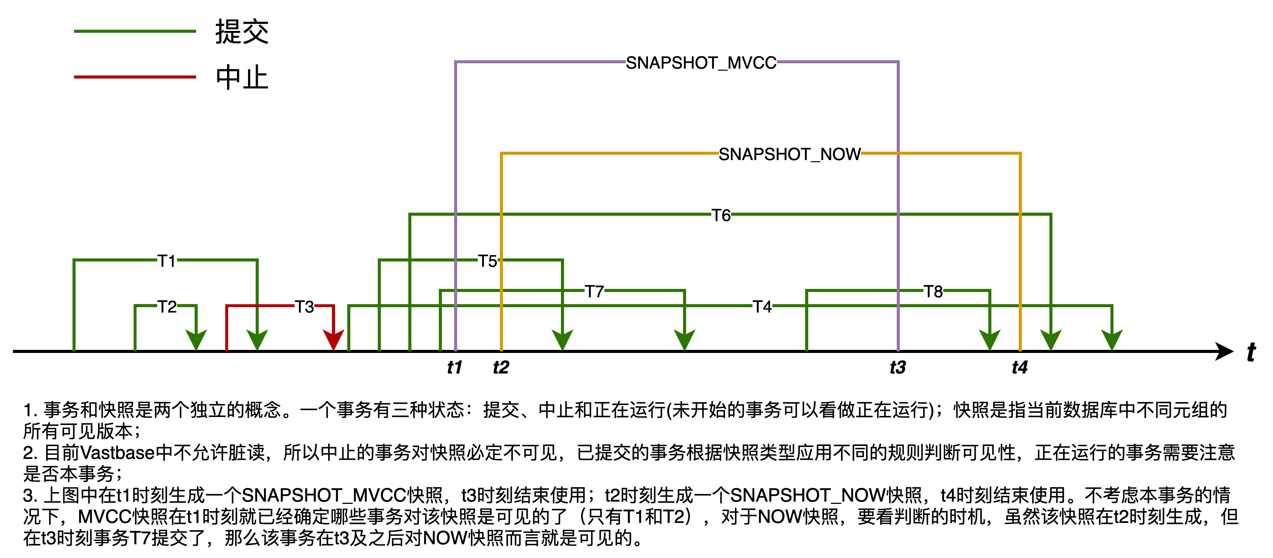
SNAPSHOT_MVCC、SNAPSHOT_NOW

Slide 19
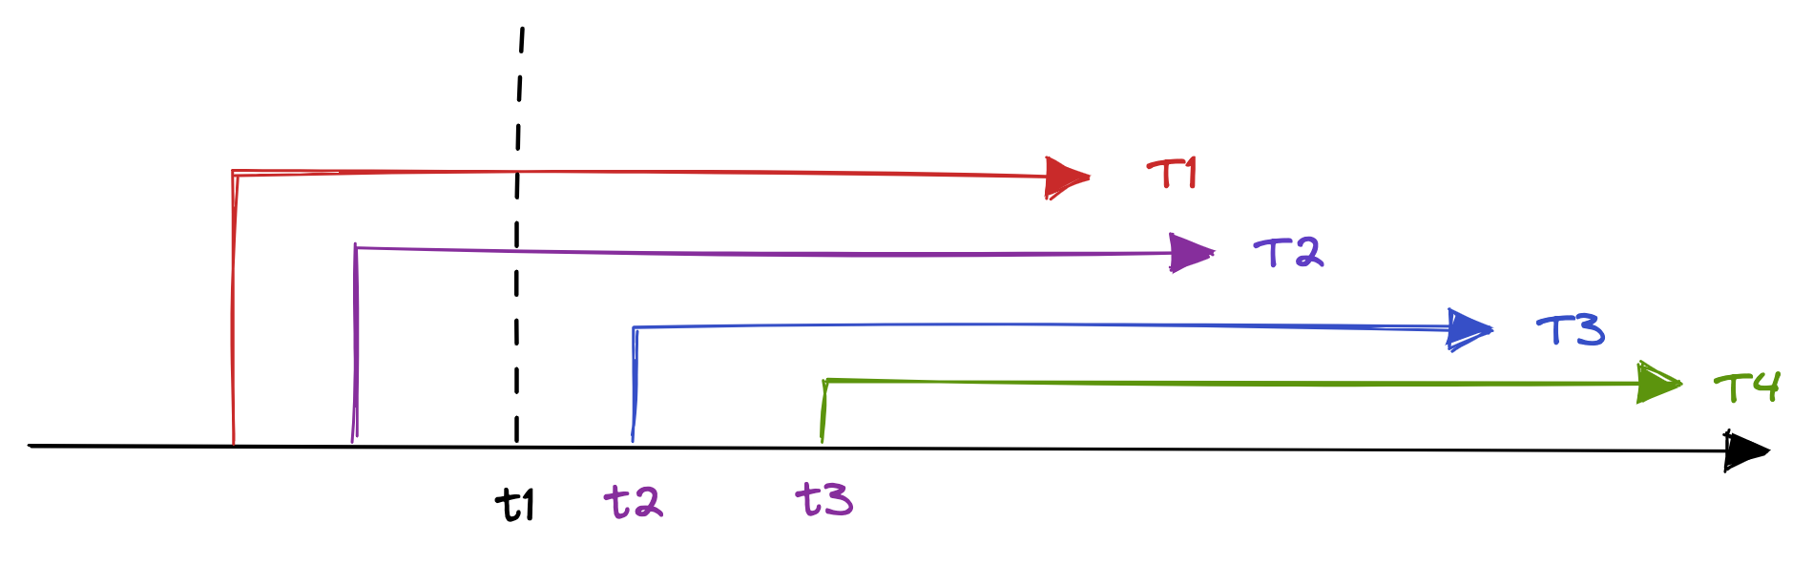
多版本快照
考虑下图所示的场景：某一时刻t1数据库中有且仅有两个事务T1、T2正在运行，时刻t2启动第三个事务T3，时刻t3启动第四个事务T4，事务T3和T4在获取快照时需要重新计算xmin和xmax么？

Slide 20
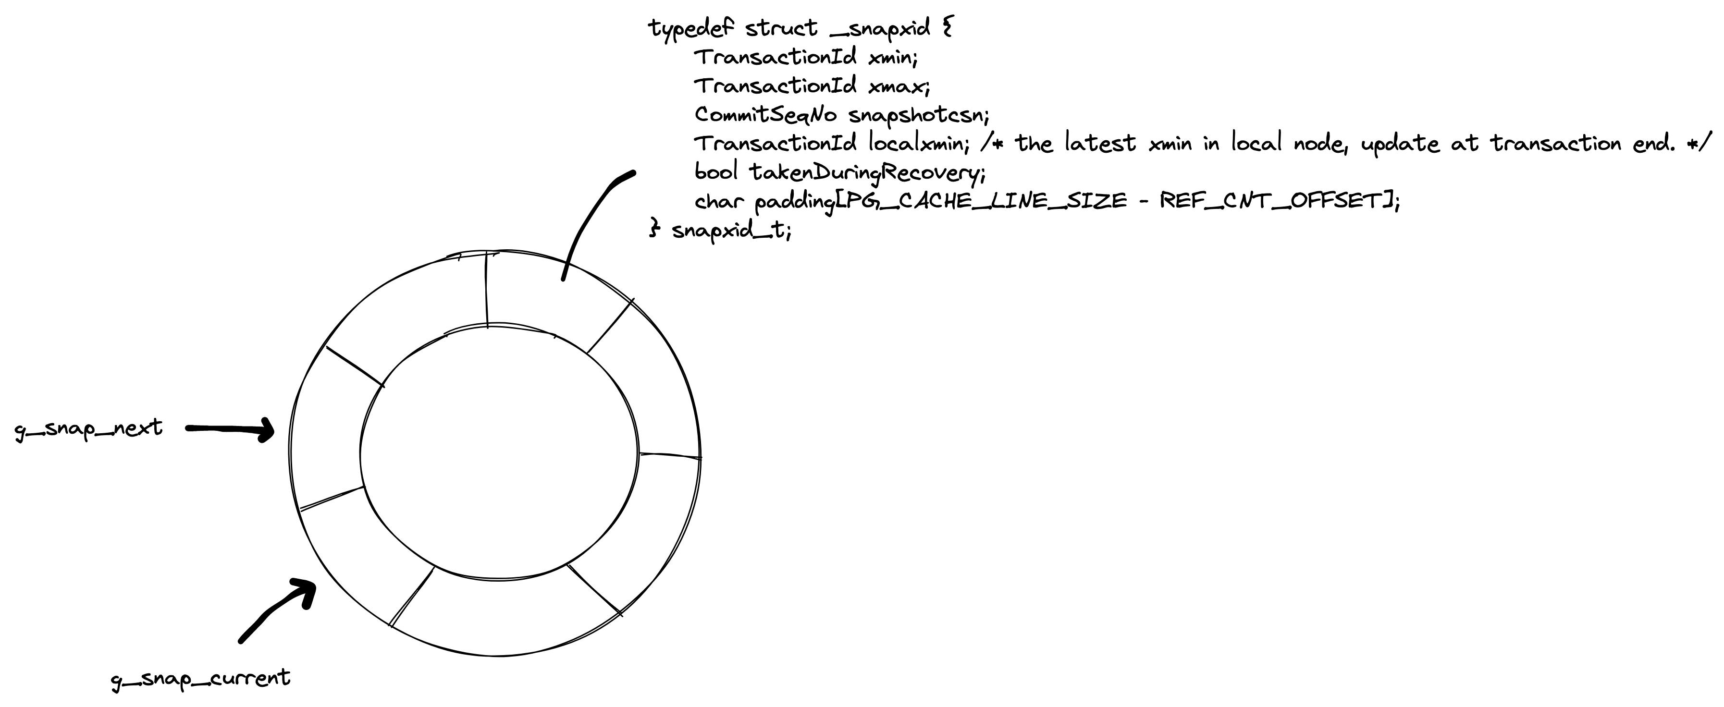
多版本快照
为了解决获取快照时需要频繁对PROCARRAY数组加锁遍历的问题，Vastbase
引入了多版本快照机制，关键点如下：
通过时间（代码写死）或者GUC参数（enable_defer_calculate_snapshot）推迟快照的计算；
在事务提交时计算快照并放入环形缓冲区中；
在需要获取快照时获取最近计算的快照；

Slide 21
MVCC snapshot
Vastbase行存引擎元组头会记录xmin、xmax，为了加速扫描过程中元组可见性判断还设置了相关bit位，比较关键的几个如下：
#define HEAP_XMIN_COMMITTED 0x0100 /* t_xmin committed */
#define HEAP_XMIN_INVALID 0x0200 /* t_xmin invalid/aborted */
#define HEAP_XMAX_COMMITTED 0x0400 /* t_xmax committed */
#define HEAP_XMAX_INVALID 0x0800 /* t_xmax invalid/aborted */
#define HEAP_XMAX_IS_MULTI 0x1000 /* t_xmax is a MultiXactId */
需要明确bit位只是标记对应的事务的状态，事务提交并不意味着对本快照可见。若未设置bit位则需要根据XID查找CLOG确认事务状态。

Slide 22
MVCC snapshot
在判断一个元组是否对MVCC快照可见时，最根本的问题是判断xmin、xmax代表的事务对本快照而言是否可见。虽然HeapTupleSatisfiesMVCC函数在实现过程中有很多分支，但把握以下两点即可：
判断事务是否已经提交；对于已经提交事务，需要判断对本快照而言是否可见；
判断事务是否当前事务，如果是当前事务，则比较cid（command id，简单来说就是判断同一个事务内操作发生的先后顺序）；

Slide 23
PART 3
CLOG、CSNLOG

Slide 24
CLOG
在Vastbase中每个事务有四种可能状态：
CLOG_XID_STATUS_IN_PROGRESS：事务正在处理中
CLOG_XID_STATUS_COMMITTED：事务已提交
CLOG_XID_STATUS_ABORTED：事务已退出
CLOG_XID_STATUS_SUB_COMMITTED：子事务已提交
故每个事务需要两个bit位来表示，每个字节可以存储四个事务的状态，在页面大小为8KB的情况下，一个页面可以存储（8192 * 1024 * 4）33554432个事务的状态。数据库在运行过程中会将事务状态持久化到文件中（$PGDATA/pg_clog/），目前内核规定每个CLOG文件包含2048个页面，若每个页面8KB，则文件大小为16MB。
例如给定事务ID：21114，可以确定该事务ID的状态位于第0号页面，第（21114/4）5279个字节，该字节内的第3和4bit表示21114的状态。

Slide 25
CSNLOG
Vastbase中为了解决负载很高的情况下活跃事务链表太长的问题引入了CSN，在判断元组可见性时会获取事务对应的CSN，和CLOG类似，Vastbase也会将CSN持久化到磁盘（$PGDATA/pg_csnlog/）。每个CSN占8个字节（最大CSN为0x0FFFFFFFFFFFFFFF），每个页面（8KB）能存储（8192 / 8）1024个CSN。其中：
COMMITSEQNO_INPROGRESS（0x0）：表示正在处理
COMMITSEQNO_ABORTED（0x1）：表示已经退出
COMMITSEQNO_FROZEN：表示已经冻结
COMMITSEQNO_FIRST_NORMAL：表示第一个CSN
CSN文件每个大小和CLOG一致，均为2048个页面。
以页面大小8KB为例，假设事务21115已经提交且持久化，利用
hexdump -s 168920 -n 8 000000000000
可以看到该事务对应的CSN。
CLOG和CSNLOG文件名均由16个16进制数字组成（PostgreSQL只有4个16进制数字），这是因为Vastbase的事务ID是8字节，而PostgreSQL是4字节。

Slide 26
PART 5
XLOG

Slide 27
常见XLOG类型
RMID | 说明（仅列举部分）
RM_XLOG_ID | XLOG_CHECKPOINT_SHUTDOWN XLOG_CHECKPOINT_ONLINE XLOG_SWITCH XLOG_FPI
RM_XACT_ID | XLOG_XACT_COMMIT_COMPACT XLOG_XACT_COMMIT XLOG_XACT_ABORT
RM_SMGR_ID | XLOG_SMGR_CREATE XLOG_SMGR_TRUNCATE
RM_DBASE_ID | XLOG_DBASE_CREATE XLOG_DBASE_DROP
RM_HEAP_ID | XLOG_HEAP_INSERT XLOG_HEAP_DELETE XLOG_HEAP_UPDATE XLOG_HEAP_HOT_UPDATE
RM_HEAP2_ID | XLOG_HEAP2_FREEZE XLOG_HEAP2_CLEAN
RM_STANDBY_ID | XLOG_STANDBY_LOCK XLOG_RUNNING_XACTS XLOG_STANDBY_CSN_COMMITTING XLOG_STANDBY_CSN

Slide 28
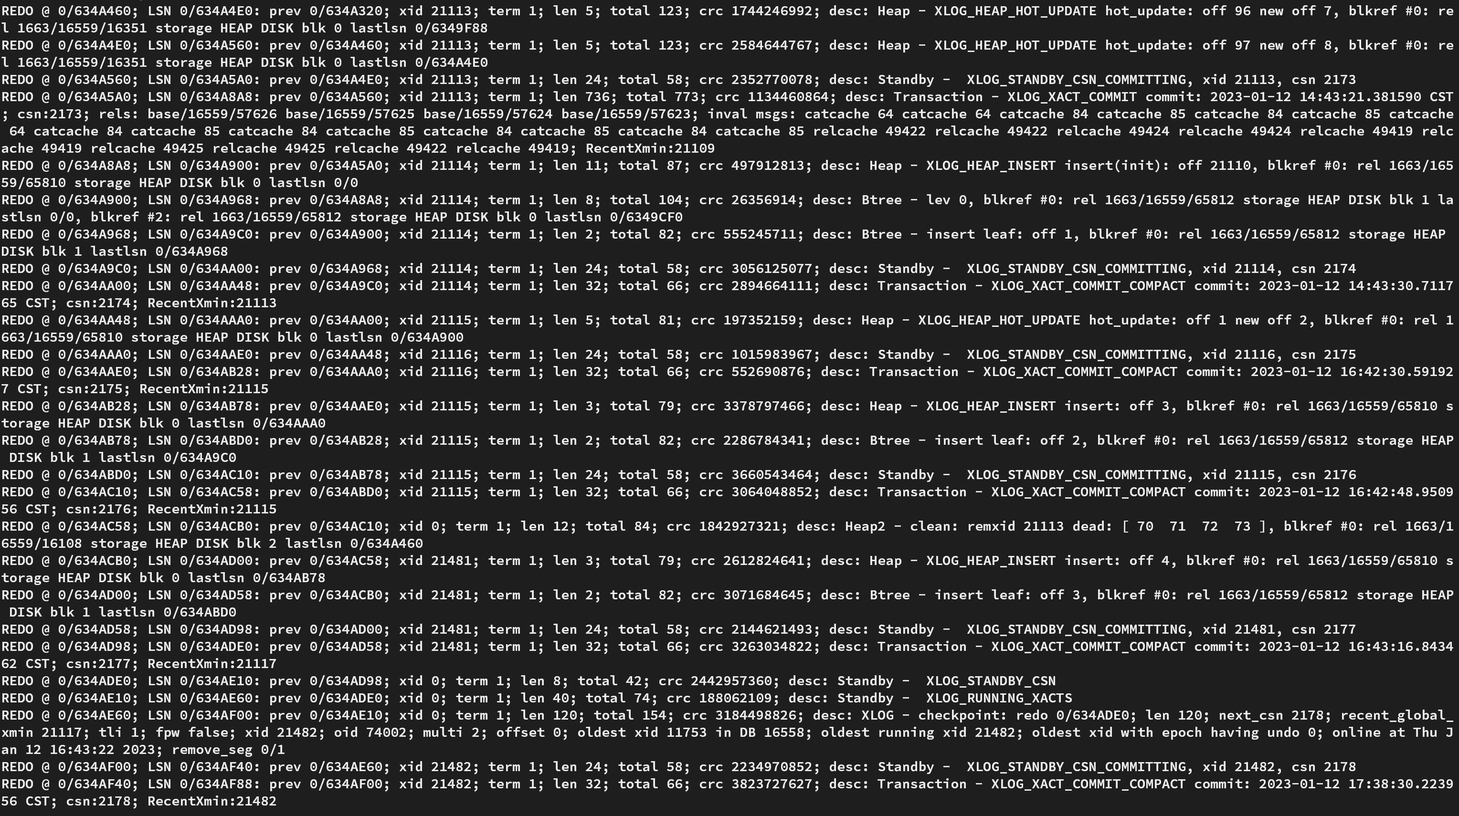

Slide 29

VASTDATA
THANKS
北京海量数据技术股份有限公司 【内部资料 严禁外传】

